Slide 1
ML project presentation SEZ SA data analysis and prediction models
Dimitris Mantaos

Slide 2
Scope of the master project
Scope of the Project is a deeper look on company's data bases with the intention to discover trends and correlations, gain commercial information, predict financial ratios , and moreover build models that will analyse unstructured data, as for example comments from customers. Specific presentation refers to 3 of the subprojects belonging to the master plan as follows :
Predict customers credit risk and payments behaviour
Evaluate the Covid crisis effect on market basket
Understand customers attitude by analysing comments .

Slide 3
Payment days delay prediction

Slide 4
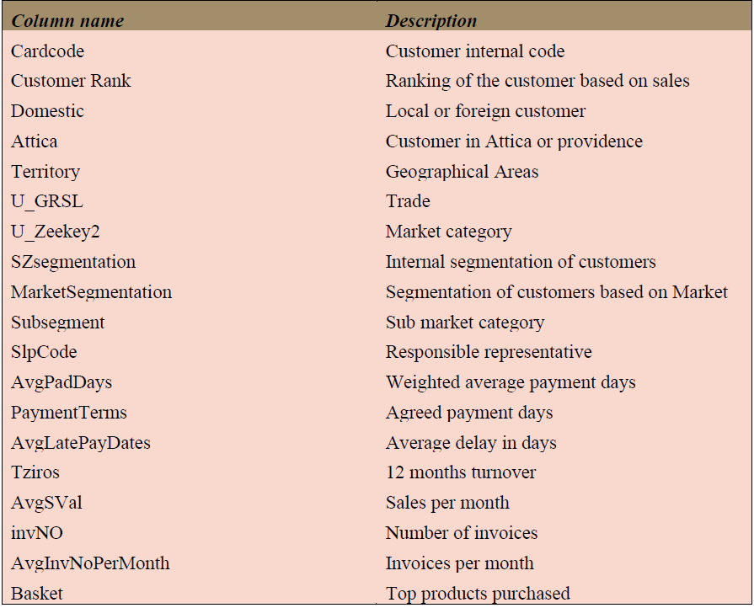
Description of datasets and methods used
The Dataset used for payments analysis consists of 19 main customers quantitative and qualitative characteristics and has 2.487 observations. Column “Cardcode” is just the code of the customer in the database, so it is omitted on any analysis that will be performed
Dataset is clear and there are not missing values or information wrong posted.

Slide 5
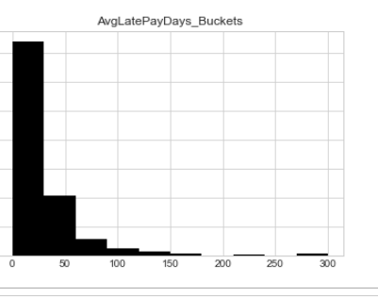
Data visualization 1
We notice that most of the delayed payments are concentrated in the range between 0 and 30 days.
Second part belongs to range between 31 and 60 days.
Observations found in the range up to 61 days is limited.
Specific data set does not include amounts due

Slide 6
Data visualization 2
We get features by pairs to investigate possible relation with payments.
As seen in plot next , Tziros and late payments do not show any obvious relation. The same applies to all important figures and gives the impression about the possible model results.
The only valuable notice is that late payments are bigger to small customers instead of big, while we should wait for the opposite.

Slide 7
Description of datasets and methods used
Dataset needs minor transformations so there was not time spent on this task.
After some experiments, Decision Trees and NN model was chosen for the prediction
Using our experience and making some assumptions about the possible relation between customers payment behaviour and existing customers segmentation, we left as predictors in the data the following features :
Tziros (Annual turnover)
Payment terms (Agreement about payments)
SZsegmentation (segmentation about the importance of the customer for the company)
After the dataset transformation we build a model with

Slide 8
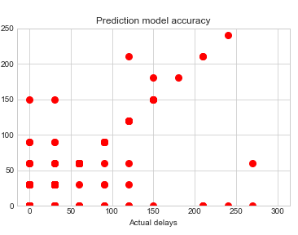
Model results analysis
The model show some effectiveness in the range of delays between 50 and 150 days.
In the range between 0 and 50 decision tree model fails to predict correct.
It is obvious that there is no pattern between customers segmentation and actual payments .

Slide 9
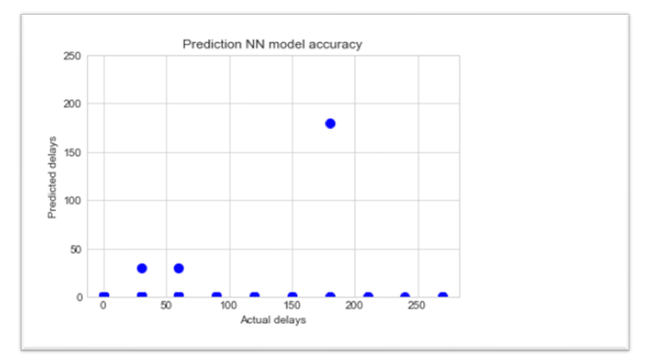
Model results analysis
MLP classifier model failed totally to predict payment delays
In all days buckets prediction falls within the range 0 to 30 days whilst actual payment days vary significantly.
It seems possible current customers segmentation to be not adequate for trustfully predicting delays in payments .

Slide 10
Covid effect on market basket

Slide 11
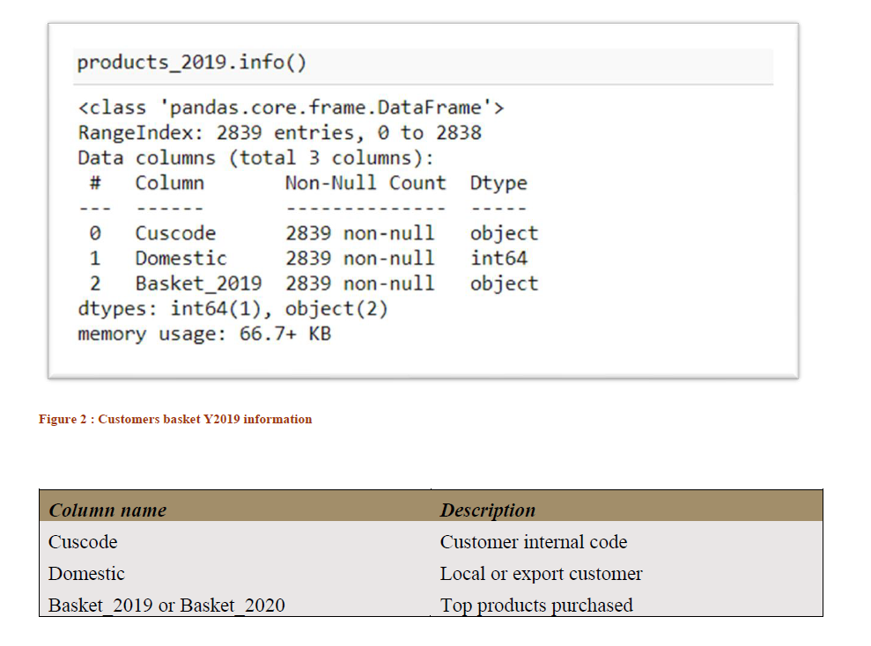
Description of datasets and methods used
The Dataset used for payments analysis consists of 19 main customers quantitative and qualitative characteristics and has 2.839 observations. Column “Cuscode” is just the code of the customer in the database, so it is omitted on any analysis that will be performed
Dataset is clear and there are not missing values or information wrong posted.

Slide 12
Description of datasets and methods used
As already mentioned dataset needs no transformation or any other adjustment.
In columns “Basket_2019” and “Busket_2020” we may found the codes of the top selling products for each customer.
Our intention is to find differences (and thus a similarity ratio) indicating changes to customers market basket caused by the Covid 19 crisis. For example we should investigate what replaced the raw materials for puff pastry products that during the crisis faced a dramatic drop down in their consumption.
Sequence Matcher and Jaccard similarity methods were used, but finally Sequence Matcher provide the most rational results
After the trials, Jaccard results were dropped, since outcome could not be explained.

Slide 13
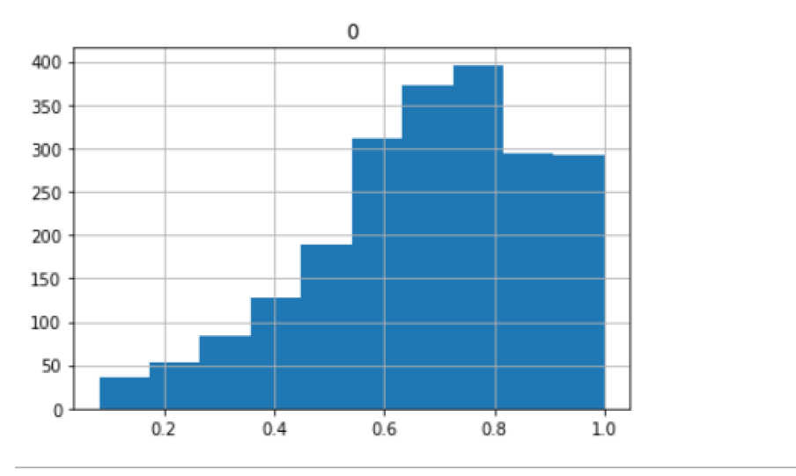
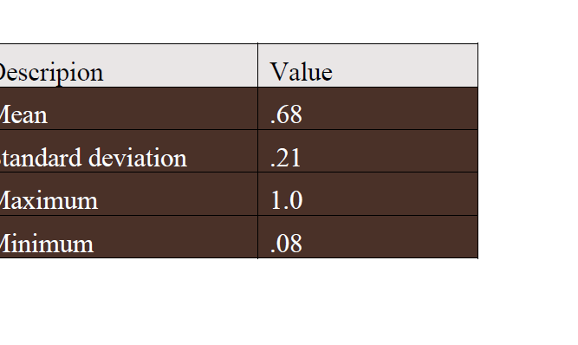
Outcome of the model
We notice that most of the observations are lied to range between .50 and 1
Variance is relatively high indicating a lot of fluctuation between customers categories
What is worth further analysis is that there are customers with similarity ratio less than .40

Slide 14
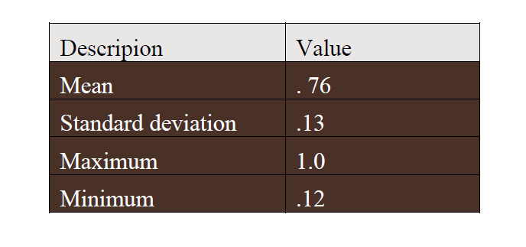
Outcome of the model – Customers of category “a”
Average ratio for category “a” is .76 higher than the average of the population which was .68
Moreover , variance (SD) is significantly less it this category . It is just .13 whilst it was .21 for the total of the customers portfolio.
Results are aligned with our expectations, since customers of category “a” are considered the more stable and reliable. What is missing from the analysis, and will be done on later stages , is the analysis of similarity ratio where we face increase in sales and not stability or decrease.

Slide 15
Comments sentiment analysis

Slide 16
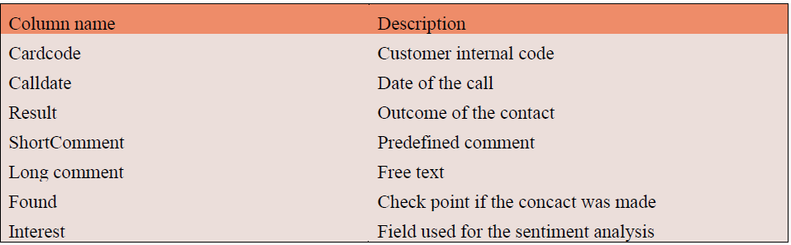
Description of datasets and methods used
Dataset consists of 7 features and has 3,346 observations. Column “Cardcode” is just the code of the customer preventing the integrity in the database, so it is omitted on any analysis that will be performed
Rows where “found” is set to 0 will be also omitted. These are tuples where customer was not available for communication.
Only the “Interest” feature will be used for the specific model . “Interest” was posted after the initial recording and express positive or negative sentiment.

Slide 17
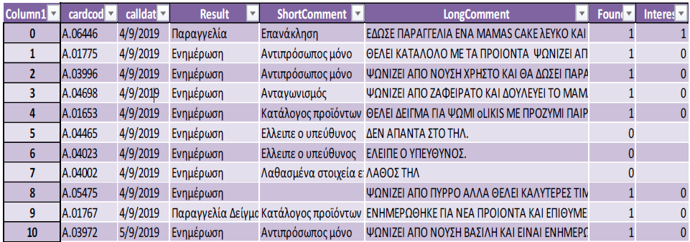
Description of datasets and methods used

Slide 18
Visualization of comments results
From the dataset is derived that Negative responses were 73,4% whilst the rest 26,6% was positive
These was the proportions on the dataset after removing the observations where the customers were absent or not found.
Result is logical since the sample was mostly on customers of category “c” or customers not longer working with the company.

Slide 19
Bring data set to desired format
After the necessary adjustments , we got a dataset containing the comment and the “pos” and “neg” response.
This dataset was used as dictionary for the prediction model

Slide 20
Tokenization of data set

Slide 21
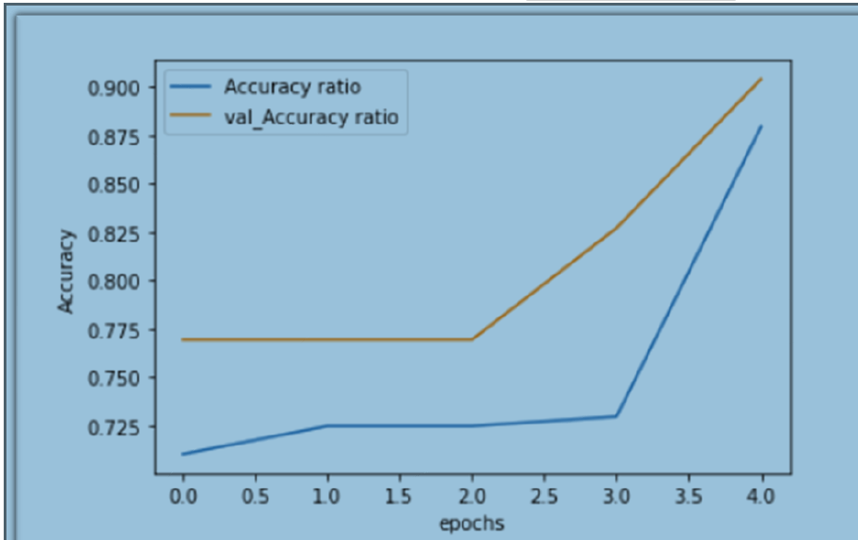
Building the model
Results of the model are shown in exhibit above . Accuracy ratio is .88 . This seems promising but possibly model is overfitting.
Just for experiment, we run the model with 10 epochs, but results were deteriorated somehow.
After all the above we were ready to build and fit a neural network model. We choose LSTM and we run it with 5 epochs.
Even if LSTM models seems proper for time series ,in our case overpassed other similar models .

Slide 22
Model for overfitting cure
Since previous model looked overfitting, we run a model using Near miss method. Results seem worst but are still promising.
It is not part of this study further analysis on this subject. For sure this will be performed when we got a bigger dataset with more substantial number of observations.

Slide 23
Future steps and interpretation of results
Data set is very small , but surprisingly we got some results that seem rational.
Data are already enriched, and next model will be trained when we got more than 10.000 observations.
It is promising that the model achieved to read and understand Greek characters.
In any case we have already built a translation module from Greek to English using googletrans.
These models, if they proved to be successful will be used in emails categorization, surveys results, and of customers clustering based on comments derived from sales force comment.
We have already initiated the speech to text option through the sales department mobile application.

Slide 24
End of presentation. Thanks for the attendance

